Slide 1
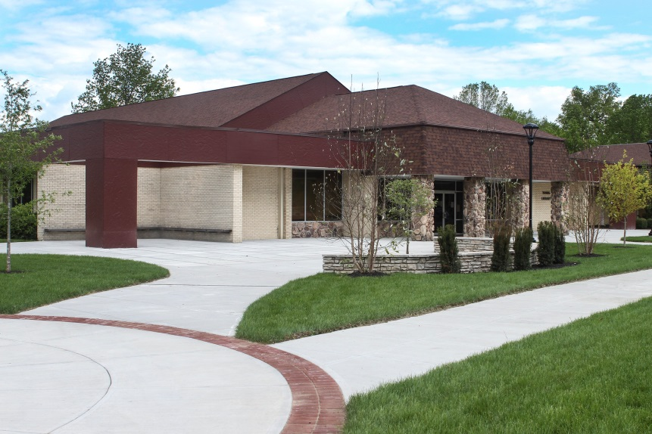
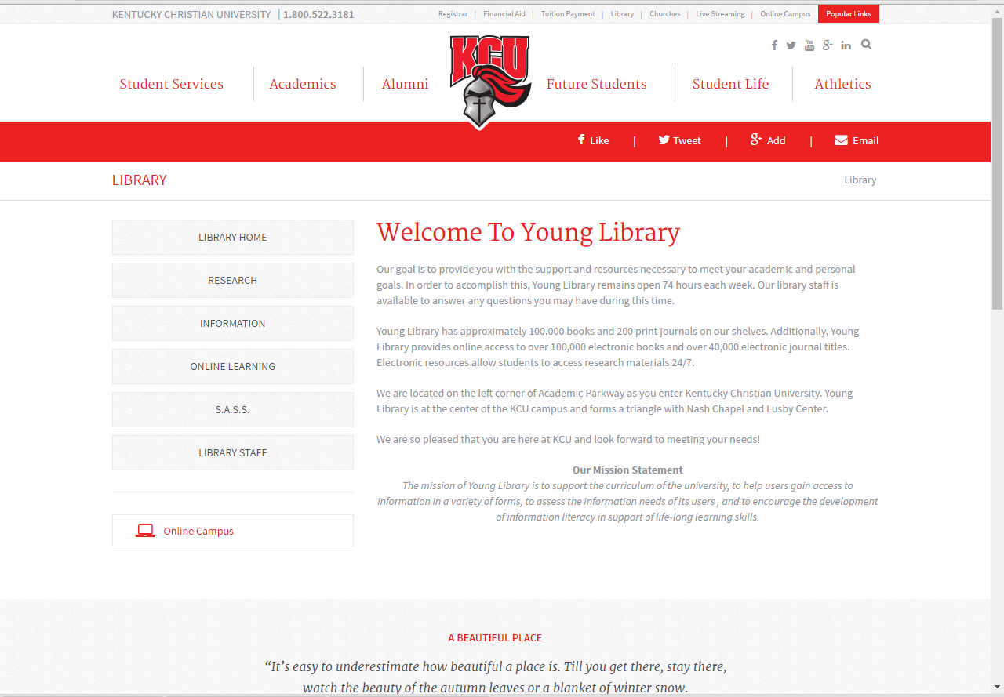
Welcome to Young Library Online

Slide 2
Young Library Online Orientation
Welcome to Young Library and your Online program. We are pleased to have you at Kentucky Christian University. This presentation is designed to help you identify and acquire information for your online assignments.
There are three areas that we will cover for your orientation:
      Navigating the Web Page
      Library Research and Terminology
      Identifying tools for information retrieval.
      An additional section provides some practice exercises.

Slide 3
Locating the Web Page
There are two ways to get to the Young Library Web page:
Use the KCU home page
  Type in the KCU URL (www.kcu.edu)
  Click on “Library” located at the top of the page or under “Quick Links” at the bottom of the page.
Go directly to the Library web page
  The Young Library URL is https://www.kcu.edu/library/

Slide 4
Notice the gray bars that are located on the left column of the page. These main headings will allow you to navigate through the web page.

Slide 5
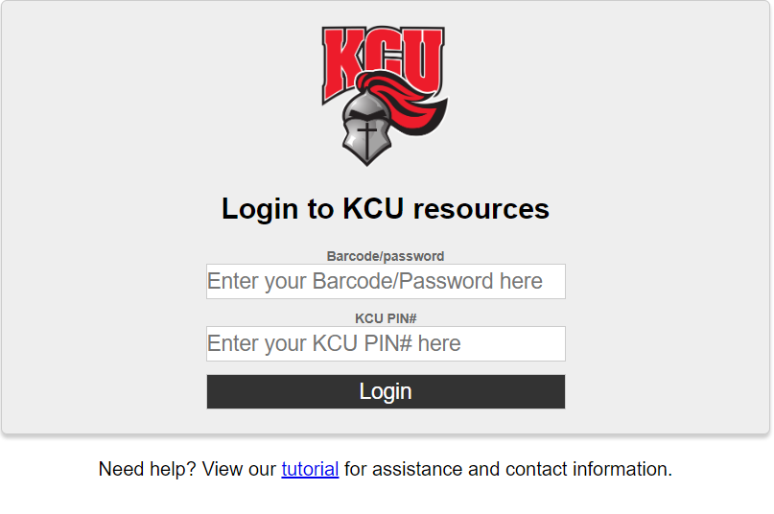
Online Learning Tab
Off Campus Access
All electronic books and subscription databases are restricted for use by KCU students, faculty, and staff. You are considered KCU students.
When you select a database such as Education Complete, you will see a request for a KCU Barcode Password and a KCU Pin #.
Your KCU Pin # is the first letter of your first name followed by your last name, all lower case.
Example: KCU PIN#: nenders
Your Barcode/Password is: the letters “kc” followed by the last 6 digits of your ID number.
Example: Barcode/Password: kc123456.

Slide 6
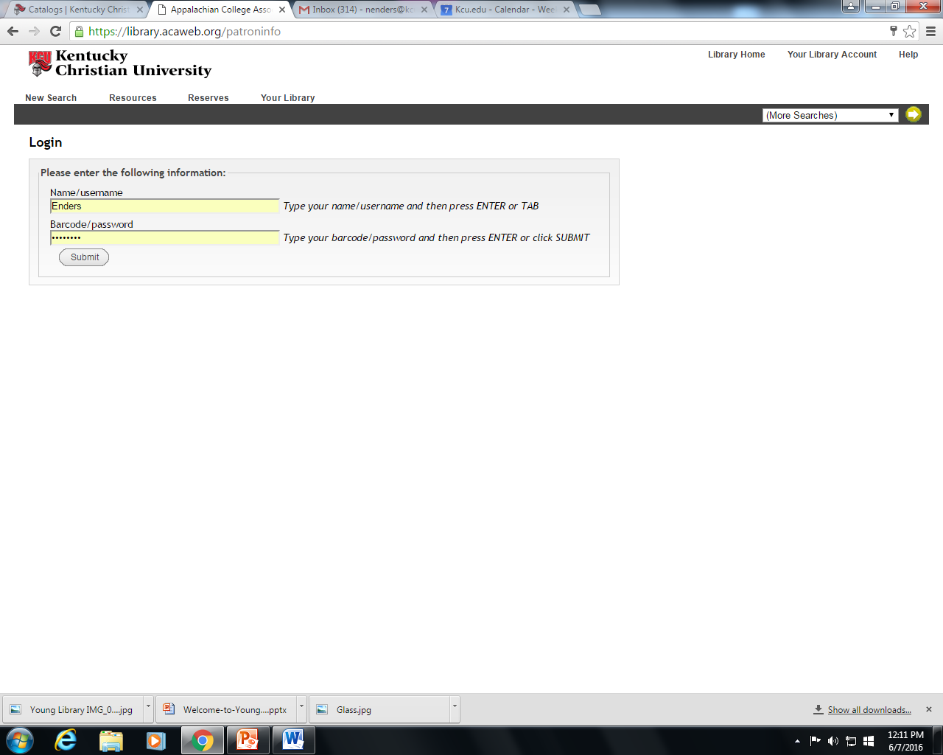
Online Learning Tab
Off Campus Access Within the Catalog
All electronic books and subscription databases are restricted for use by KCU students, faculty, and staff. You are considered KCU students.
When you select an ebook in the catalog, the library system will ask you for a User Name and Password.
Your User Name is your last name only with the first letter capitalized.
Example: Name/User name: Enders
Your Barcode/Password is: the letters “kc” followed by the last 6 digits of your ID number.
Example: Barcode/Password: kc123456.

Slide 7
Online Learning Tab
Tutorials
Under the Online Learning Tab you will also find a page titled “Tutorials”.
These tutorials are You Tube videos to help you search for, retrieve, and organize your research information.
These videos are about the EBSCO platform but will give you a general idea of how to search for articles
You will also find tutorials that are on specific databases for Education majors. These will help you to find articles in your target areas.

Slide 8
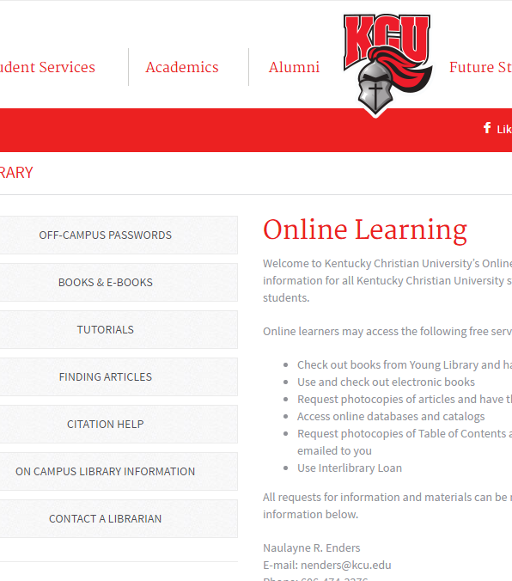
Online Learning Tab
Finding Books and Articles
To your left on the Online learning tab you will see a menu of pages.
Using these pages you can navigate to instructions on how to find print titles, electronic books, journals, and journal articles.
You may want to print off these instructions to minimize clicking multiple times

Slide 9
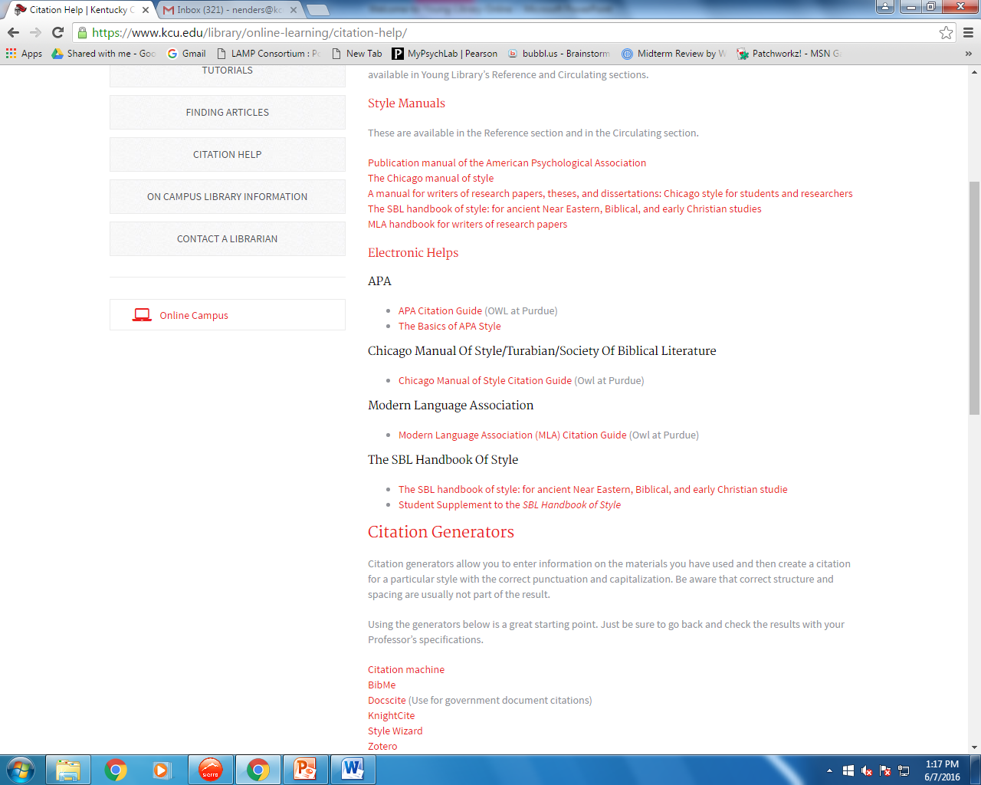
Online Learning Tab
Citation Help
APA style is the standard for the Education department’s Graduate programs citations. These links will help in using this style.
At the bottom of the “Citation Help” page is a list of links to Citation generators. These are easy ways to create a starting point for the citations of your sources. We highly recommend that you consider using Zotero Bib as your generator. It is a free generator designed for college and research use.
Be sure to check all citations against the style book recommended by your course instructor. Citation generators are not foolproof.

Slide 10
Research Tab
Databases
Databases in the library are collections of articles.
You will find that all of our databases are grouped into subject specific areas in our Databases list.
“General” databases provide coverage of many topic areas and includes online reference materials.
“Education” databases will focus on finding information from Education specific journals.
Catalogs
A catalog lets you identify and locate materials in libraries
Young Library has an “Online catalog” that allows you to find and identify print titles and electronic books
Young Library also has access to “WorldCat”. This is an international library catalog. Items that you locate on this catalog can be requested from other libraries free of charge.

Slide 11

Library Research Terminology
All professions and fields of study have a language that is unique to them. This includes acronyms and words that are defined differently.
For example, think of the word “station”. As an Education major the first thing you think of when you hear the word is a series of hands on activities for students. However, a train engineer who hears the word might think “station” and think about where the train engine is stopping.
The following list of terms should help you to successfully communicate and understand how particular terms are used in Young Library and on KCU’s campus.

Slide 12
Library Research Terminology
Catalog
ISSN
A catalog is a method of organization that allows items in a library to be located and retrieved.
Young Library’s catalog is online
You also have access to WorldCat, an international online catalog.
ISSN is a library acronym for “International Standard Serial Number”
It is usually located on the back side of the title page of a journal.
This helps us to make sure that we are getting the correct journal that you want and not a journal that has a similar title.
It also helps us track if journals have a name change.

Slide 13
Library Research Terminology
ISBN
DOI
ISBN is a library acronym for “International Standard Book Number”.
All books published after 1970 are given this unique number.
It is usually located on the back side of the title page of the book or on the back cover of the book.
This number can be typed into ZoteroBib to generate your citation for the book that you are using.
DOI is a library acronym for “Direct Object Identifier”.
They were first used in 2000 and are a unique number assigned to individual articles.
It is usually located within the detailed information for an article.
This number can be placed into your citation generator to get your citation.
These numbers usually begin with the number “10” and appear, for example, as ‘doi:10.1000/182’.
Sometimes a URL will be included. To use within a generator, you only want to use the part starting with the number ‘10’. Ex: https://doi.org/10.1000/182

Slide 14
Library Research Terminology
Database
Platform
A database is a collection of information.
In Young Library, Databases are collections of journal articles, streaming videos, and reference materials
Databases are located on the “Research” tab of the library web page
https://www.kcu.edu/library/research/databases/
A platform is a structure within a database that allows you to search for articles and retrieve that information
The same platform is used by vendors.
For example, Education Source and Academic Search Complete are both EBSCO databases. They run on the EBSCO platform and will look and operate the same way.

Slide 15
Library Research Terminology
Session
Results List
To locate articles in a database, topic terms are typed into the search box(es).
A completed search will yield a list of articles that pertain to the subject.
A session is the continuous time that you are searching within databases.
Each time that you exit out of the Young Library databases and then have to reopen them, a new session begins.

Slide 16
Library Research Terminology
Primary Source
Secondary Source
The research in this article or book resource is conducted and written by the same person.
The author has developed the hypothesis and the test.
The article or book is written by an expert who has read many different papers on an issue and used all of them to form an evaluation.
The author has synthesized the information, not done the original research.

Slide 17
Library Research Terminology
Tertiary Sources
White Pages or Grey Literature
Tertiary resources are also known as reference materials.
Examples of these items are encyclopedias, dictionaries, and thesauri
Tertiary sources should be used for background information
White pages or grey literature are unpublished or non-commercially published forms of information.
An example of this type of resource would be an interview that you have conducted.

Slide 18
Library Research Terminology
Peer-reviewed sources
Non-Peer-reviewed sources
Experts in the particular subject of the article, have read an article and decided that it adds to the overall body of knowledge and should be published.
Reporters or writers have written an article that summarizes what someone has told them about a particular topic.

Slide 19
Library Research Tools
Library Tools allow you to find and retrieve research materials. Young Library has two main tools that will help you to acquire this information:
        Catalogs
        Databases
Tutorials are available on all of these tools. Video tutorials are located on the Young Library web page under Online learning (https://www.kcu.edu/library/online-learning/tutorials/). Printable tutorials are available under the Research tab (https://www.kcu.edu/library/research/tutorials/)

Slide 20

Library Research Tools
CATALOGS
Online Catalog
Using the online catalog allows you to locate:
  Electronic books
  Print books
  Print journal titles
  Streaming video
Electronic books located within the catalog can be accessed and used from your home computer. You will need to provide the off-campus Barcode/Password and KCU Pin #. This information can be found on the Online Learning tab of the Young Library web page.
Print materials that you may need can be checked out at Young Library. You may also request that print materials be mailed to you. Directions for requesting and mailing are available on the library web page. (https://www.kcu.edu/library/online-learning/books-e-books/).

Slide 21
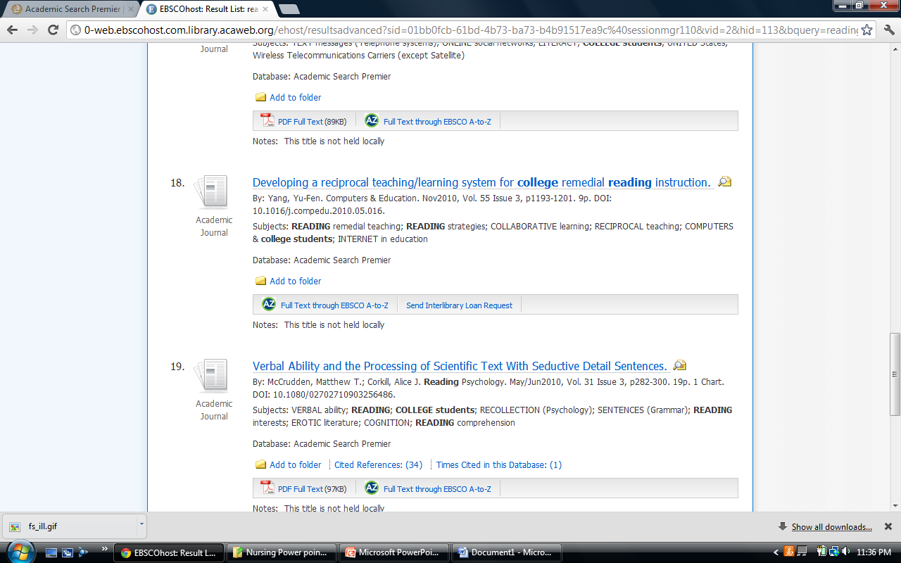
Library Research Tools
Databases
Databases will provide you with electronic journal articles and electronic reference books.
Articles available in full text can be saved or downloaded for student use immediately.
  PDF documents will look exactly like they do if you open up a magazine. This is the best format to use for articles.
  HTML documents will look like a continuous Word document with no page numbers or graphics. If this is the only format available it will be fine but it should not be your first choice if a PDF exists.
Articles that say “Send Interlibrary Loan Request” can be acquired by clicking on the link provided.

Slide 22
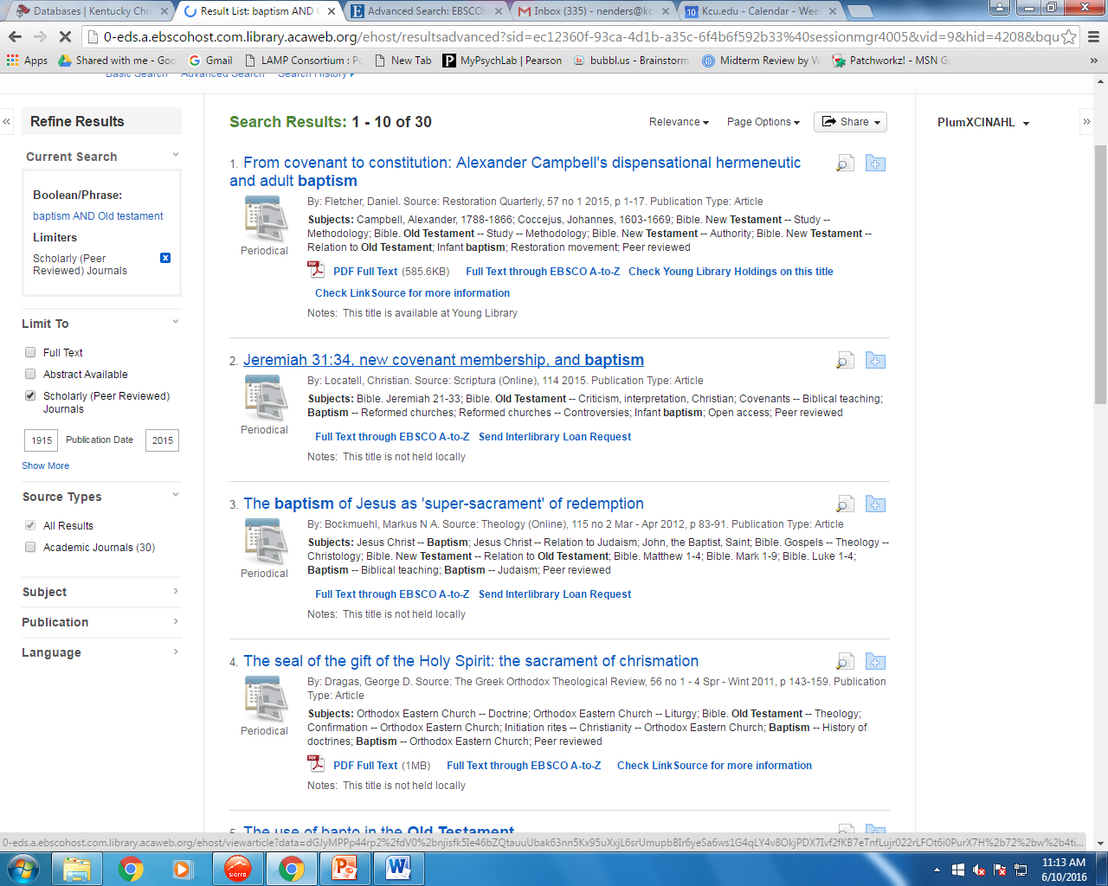
Library Research Tools
Interlibrary Loan
Articles that are not available in full text within the database can be requested through Interlibrary Loan.
For EBSCO databases you will need to click on the “Send InterLibrary Loan request” link at the bottom of the article title in the results list.
For other databases you will need to use the form provided in the “resources” area of the Online Catalog. (https://www.kcu.edu/wp-content/uploads/2014/09/Inter-Library-Loan-Forms-and-Information.pdf)
Be sure to fill out all of the requested information. All requests must give us a 10 day window to locate the article or book.

Slide 23
Library Research Tools
Helpful Hints for Education Research
As you retrieve your results from a database search, be sure to read each citation. Look for terms like “Research article” at the end of the citation. Also be sure to select for “Peer-reviewed articles” in the left hand column.
Be sure to look at the references at the end of any article that contains the exact information you are looking for. It will help you find additional articles on your topic that may not appear in your initial key word search.
Look at the search terms under the word “Subjects” on your results list. They can help you find terms that you may never have discovered on your own.

Slide 24
Congratulations!
You have reached the end of the Young Library Online Orientation.
I encourage each of you to contact the library if you have any questions or need any help.
Technology changes rapidly. It is our job to keep up with those changes. It is your job to utilize the people and resources available to you.
Take a few minutes to complete the following searches for practice.
Have a wonderful day!

Slide 25
DATABASES – Using Your Google Folder
EBSCO has recently added a Google Drive icon that will allow you to save articles directly into a Google folder. This button saves you clicks and works extremely well.
This saves you time and allows you to keep your citations in one place.

Slide 26
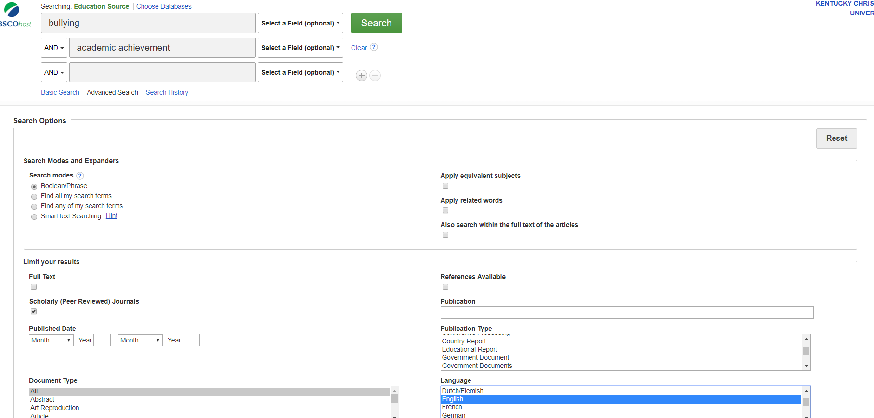
DATABASES – Searching Education Source
By Subject
Advanced Search Screen
Open the Education Source database
In the first box type “bullying”
In the second box type “academic achievement”
Scrolling down the Advanced search screen, select the following limits:
  Scholarly (Peer-reviewed)
  English language
Look at article # 9 – The title of the Full Text article should be “School Administrator Assessments of Bullying and State-Mandated Testing”

Slide 27
DATABASES – Searching CINAHL
Answer
Sometimes the numbers are not identical from search to search since new articles are always being added. Look at the surrounding articles to see if you can find the title.
Still can’t find it?
Did not work? Contact your librarian.

Slide 28
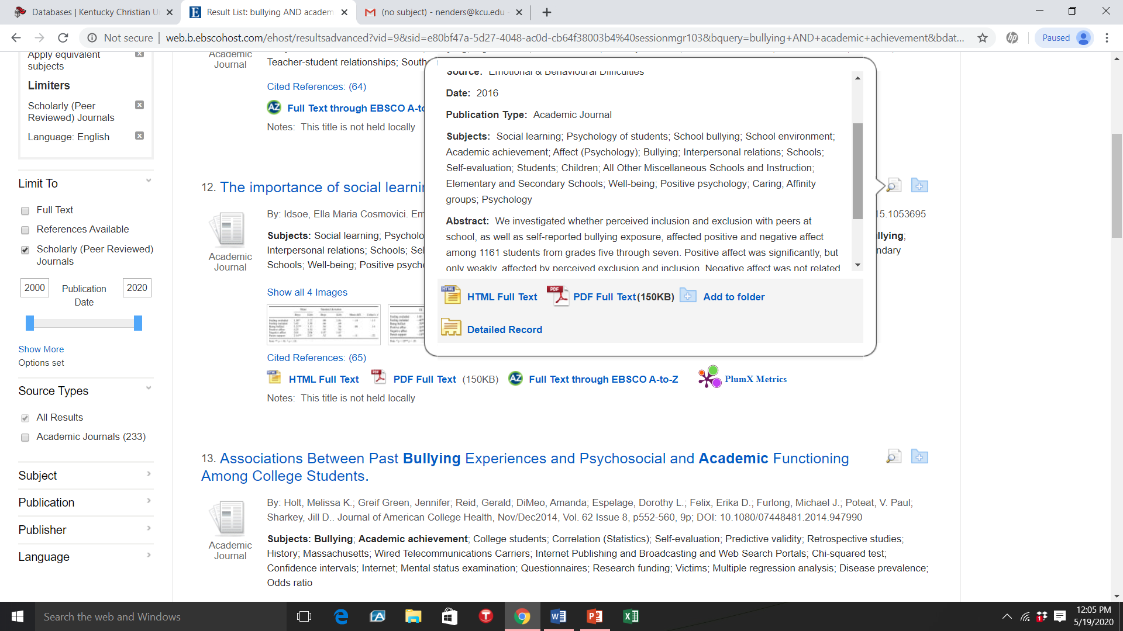
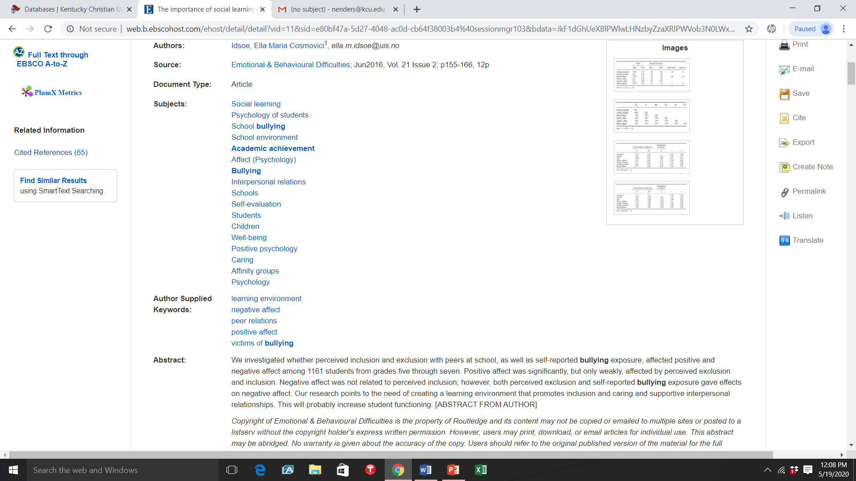
DATABASES – Navigating the result list
Evaluation Tools
Advanced Search Screen
Look at the article #12 – “The importance of social learning environment factors for affective well-being among students”.
Holding your cursor over the magnifying glass at the end of the title shows a summary of the article.
Click on the title. You will see a list of items such as author credentials, subject terms and publication type

Slide 29
DATABASES – Practice Question #1
1. Article #17 – “Peer group ethnic diversity and social competencies in youth attending rural middle schools” says to “Check Young Library holdings”. Click on this link and determine if the issue is available in print at the library.

Slide 30
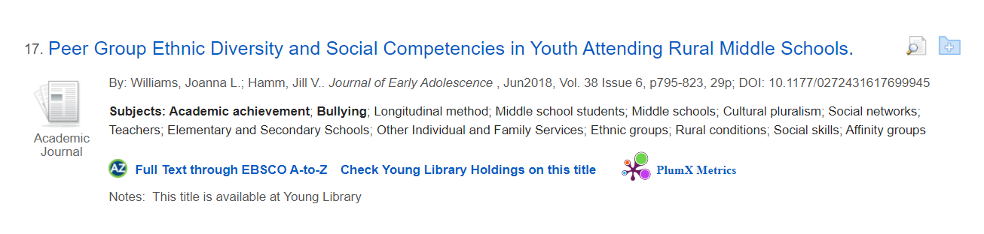
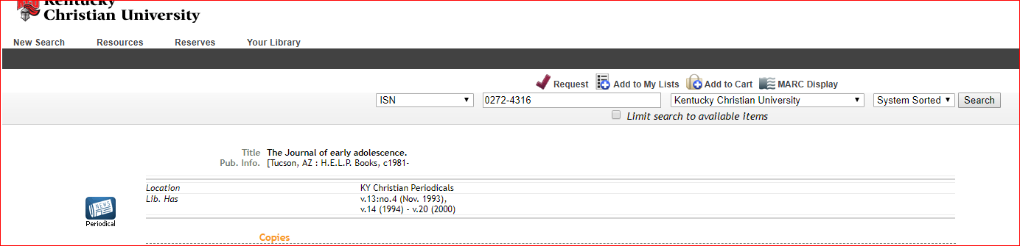
DATABASES – Practice Question #1
Answer
Article #17 – “Peer group ethnic diversity and social competencies in youth attending rural middle is not available in Young Library.
  In the citation this article is in the Journal of Early Adolescence and is in the June 2018 issue. This is Volume 38 Issue 6
  Clicking on the link opens the library catalog. The last library holdings (Look for “Library has”) ends with Volume 20 (2000). This means that the article is not available in the library but it can be requested through Interlibrary Loan.

Slide 31
DATABASES – Practice Question #3
3. Article #1 – “Understanding children with cerebral palsy and bullying: A mixed methods approach.” says to “Send Interlibrary Loan Request”. Click on this. Your filled in request form should appear. What are the pieces of information that you need to complete the form?

Slide 32
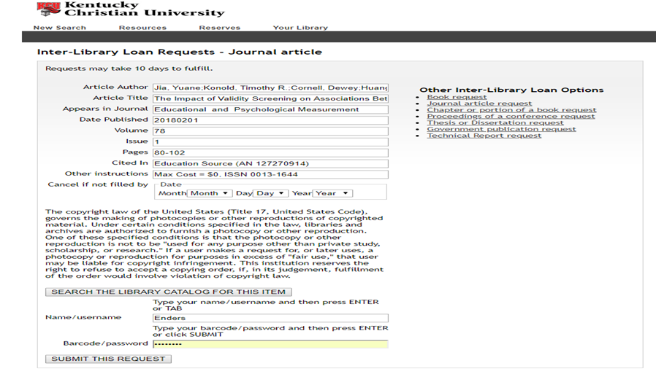
DATABASES – Practice Question #3
Answer
3. Article #3 – “The Impact of Validity Screening on Associations Between Self-Reports of Bullying Victimization and Student Outcomes.” needs three pieces of information:
  Your Name/Username – Last name only first letter capitalized
  Your Barcode/Password – “kc” plus the six digits of your ID number
  The Date that you need the article by

