Slide 1
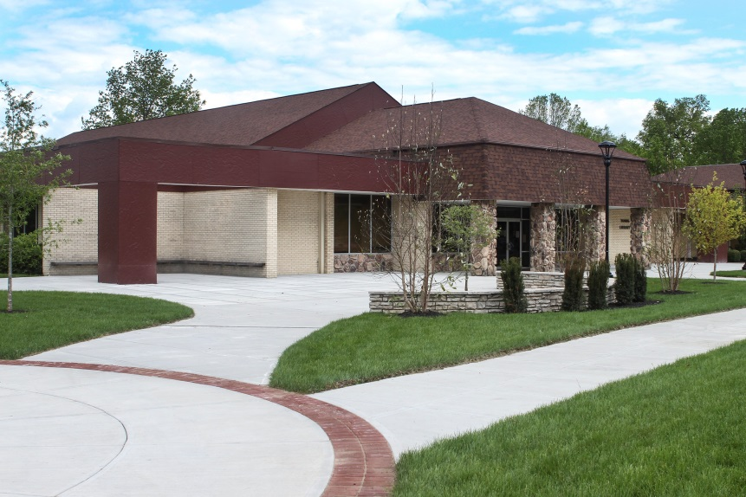
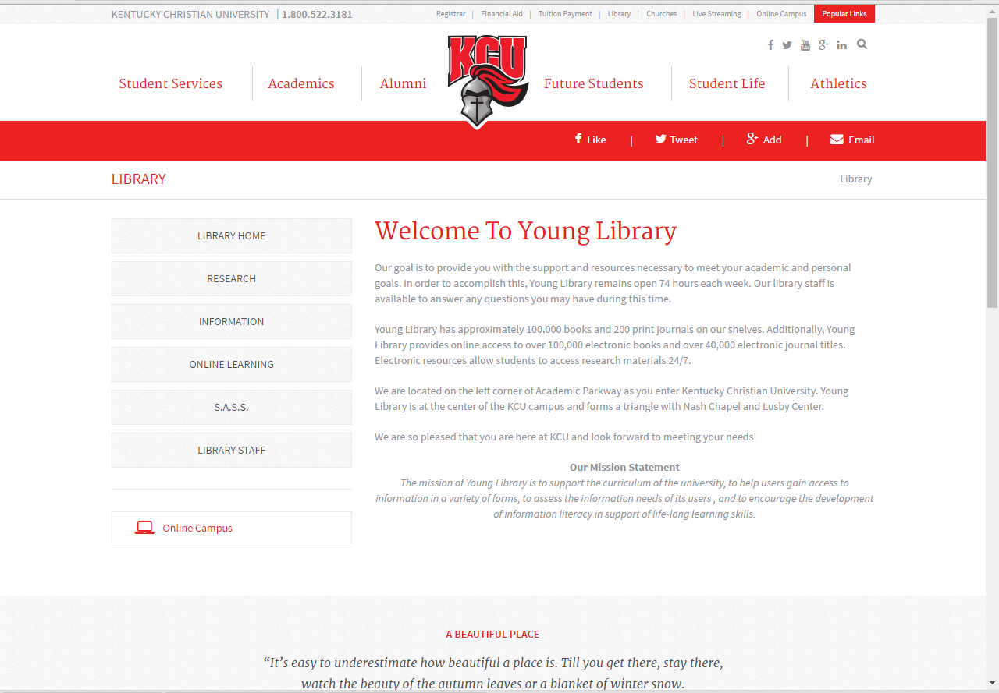
Welcome to Young Library Online

Slide 2
Young Library Online Orientation
Welcome to Young Library and your Online program. We are pleased to have you at Kentucky Christian University. This presentation is designed to help you identify and acquire information for your online assignments.
There are three areas that we will cover for your orientation:
      Navigating the Web Page
      Library Research and Terminology
      Identifying tools for information retrieval.
      An additional section provides some practice exercises.

Slide 3
Locating the Web Page
There are two ways to get to the Young Library Web page:
Use the KCU home page
  Type in the KCU URL (www.kcu.edu)
  Click on “Library” located at the top of the page or under “Quick Links” at the bottom of the page.
Go directly to the Library web page
  The Young Library URL is https://www.kcu.edu/library/

Slide 4
Notice the gray bars that are located on the left column of the page. These main headings will allow you to navigate through the web page.

Slide 5
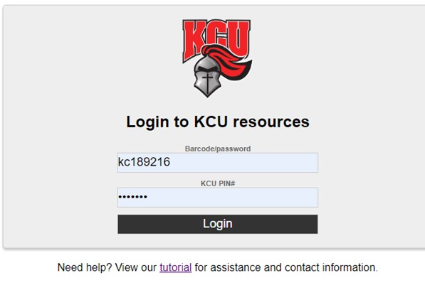
Off-Campus Access
All electronic books and subscription databases are restricted for use by KCU students, faculty, and staff. You are considered KCU students.
When you select databases or catalog items such as electronic books, the library system will ask you for a Barcode/Password and a KCU Pin #.
Your Barcode/Password is: the letters “kc” followed by the last 6 digits of your ID number.
Example: Barcode/Password: kc123456.
Your KCU Pin # is: the first letter of your first name followed by your last name – all lowercase
Example: KCU Pin # : nenders
This information can also be located on the Online Learning Tab under “Off-Campus Passwords”
“Off-Campus Passwords”

Slide 6
Online Learning Tab
Tutorials
Under the Online Learning Tab you will also find a page titled “Tutorials”.
These tutorials are You Tube videos to help you search for, retrieve, and organize your research information.
These videos are about the EBSCO platform but will give you a general idea of how to search for articles
You will also find tutorials that are on specific Nursing databases. These will help you to find articles in your target areas.

Slide 7
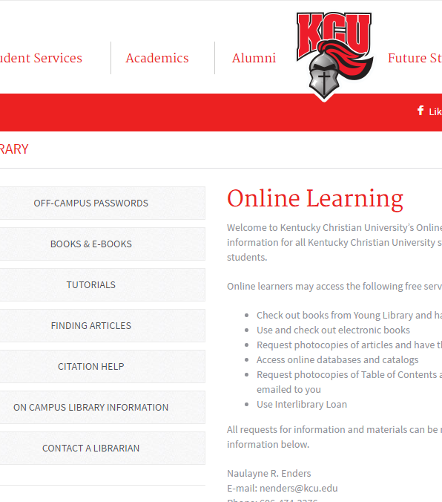
Online Learning Tab
Finding Books and Articles
To your left on the Online learning tab you will see a menu of pages.
Using these pages you can navigate to instructions on how to find print titles, electronic books, journals, and journal articles.
You may want to print off these instructions to minimize clicking multiple times

Slide 8
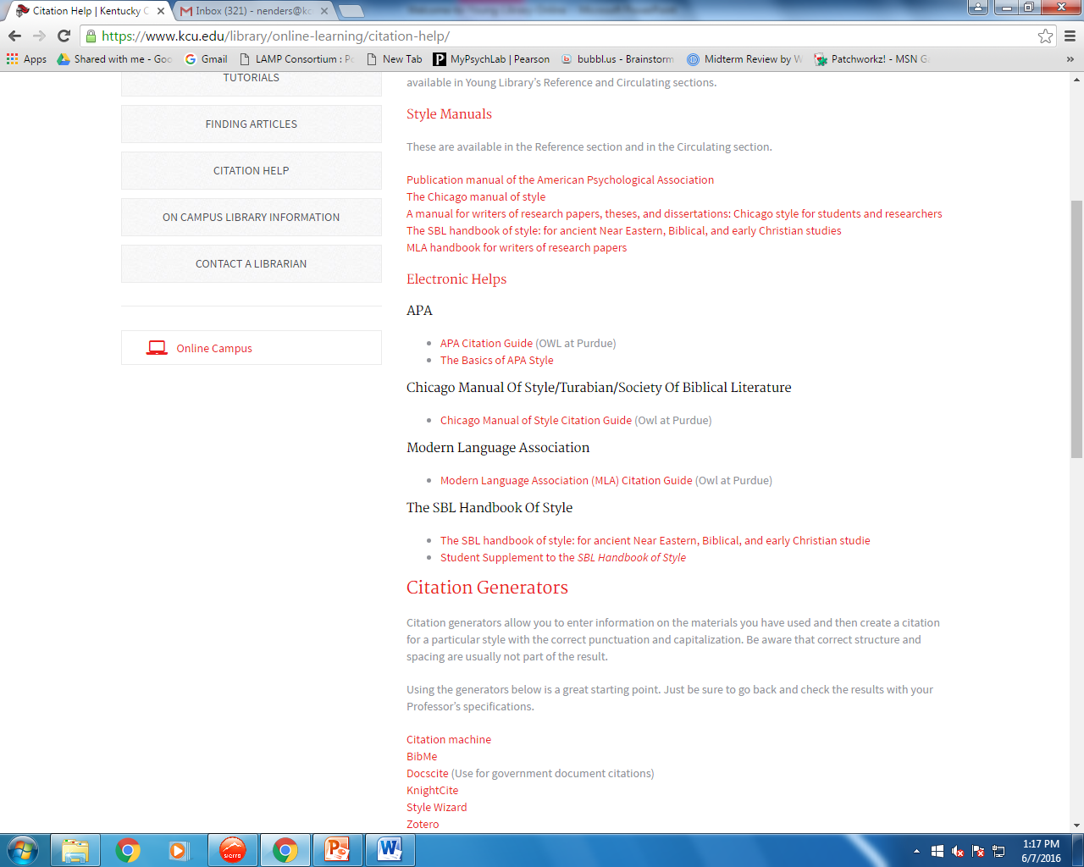
Online Learning Tab
Citation Help
APA style is the standard for the Nursing Program. These links will help support the instructions in your APA manual.
At the bottom of the “Citation Help” page are list of links to Citation generators. These are easy ways to create a starting point for the citations of your sources
Be sure to check all citations against the style book recommended by your course instructor.

Slide 9
Research Tab
Databases
Databases in the library are collections of articles.
You will find that all of our databases are grouped into subject specific areas in our Databases list.
“General” databases provide coverage of many topic areas and includes online reference materials.
“Nursing” databases will focus on finding information from Nursing specific journals.
Catalogs
A catalog lets you identify and locate materials in libraries
Young Library has an “Online catalog” that allows you to find and identify print titles and electronic books
Young Library also has access to “WorldCat”. This is an international library catalog. Items that you locate on this catalog can be requested from other libraries free of charge.

Slide 10

Library Research Terminology
All professions and fields of study have a language that is unique to them. This includes acronyms and words that are defined differently.
For example, think of the word disc. As a nurse the first thing you think of is a spinal disc. However, a computer programmer might think of a computer storage device.
The following list of terms should help you to successfully communicate and understand how particular terms are used in Young Library and on KCU’s campus.

Slide 11
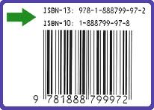
Library Research Terminology
Catalog
ISBN
ISBN is a library acronym for “International Standard Book Number”
It is located on the back side of the title page of a book (Verso page).
This helps us to make sure that we are getting the correct book that you want and not a book that has a similar title.
A catalog is a method of organization that allows items in a library to be located and retrieved.
Young Library’s catalog is online
You also have access to WorldCat, an international online catalog.

Slide 12
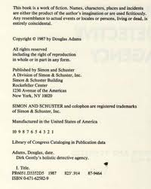

Library Research Terminology
Title Page
Verso Page
This is the back side of the title page.

Slide 13
Library Research Terminology
Database
Platform
A database is a collection of information.
In Young Library, Databases are collections of journal articles, streaming videos, and reference materials
Databases are located on the “Research” tab of the library web page
https://www.kcu.edu/library/research/databases/
A platform is a structure within a database that allows you to search for articles and retrieve that information
The same platform is used by vendors.
For example, CINAHL Complete, and Academic Search Complete are both EBSCO databases. They run on the EBSCO platform and will look and operate the same way.

Slide 14
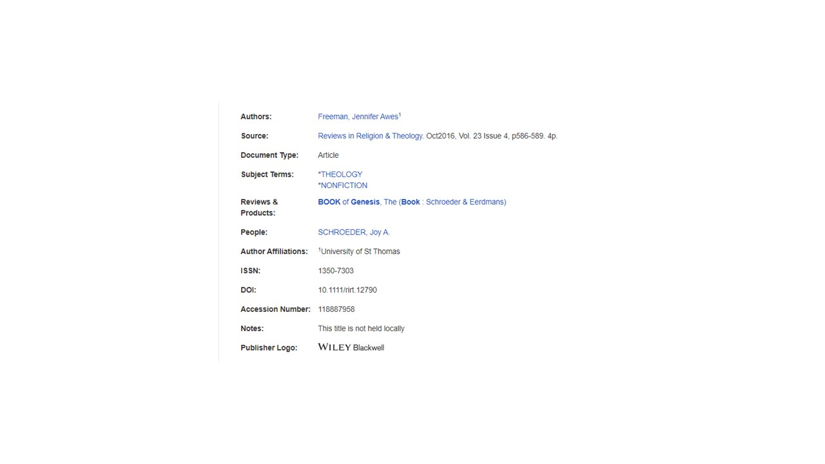
Library Research Terminology
Database
DOI
A database is a collection of information.
In Young Library, Databases are collections of journal articles, streaming videos, and reference materials
Databases are located on the “Research” tab of the library web page and are divided into subject specific areas
https://www.kcu.edu/library/research/databases/
A DOI is an acronym for a “Direct Object Identifier”
In a Database, you can click on the title of an article in the Results list.
Look in the left hand column in bold for the DOI. The number usually starts with the # 10

Slide 15
Library Research Terminology
Session
Results List
To locate articles in a database, topic terms are typed into the search box(es).
A completed search will yield a list of articles that pertain to the subject.
A session is the continuous time that you are searching within databases.
Each time that you exit out of the Young Library databases and then have to reopen them, a new session begins.

Slide 16
Library Research Terminology
Primary Source
Secondary Source
The research in this article or book resource is conducted and written by the same person.
The author has developed the hypothesis and the test.
The article or book is written by an expert who has read many different papers on an issue and used all of them to form an evaluation.
The author has synthesized the information, not done the original research.

Slide 17
Library Research Terminology
Tertiary Sources
Non-documentary sources
Tertiary resources are also known as reference materials.
Examples of these items are encyclopedias, dictionaries, and thesauri
Tertiary sources should be used for background information but should not be used in your citation information
Non-documentary sources are unpublished forms of information
An example of this type of resource would be an interview that you have conducted.

Slide 18
Library Research Terminology
Peer-reviewed sources
Non-Peer-reviewed sources
Experts in the particular subject of the article, have read an article and decided that it adds to the overall body of knowledge and should be published.
Reporters or writers have written an article that summarizes what someone has told them about a particular topic.

Slide 19

Library Research Terminology
Quantitative Research
Qualitative Research
Definition – Of or pertaining to measurement.
Example: Weight loss of each student in one month who ate fruit every day for breakfast instead of poptarts.
American Heritage Dictionary, 2nd college edition, 1982.
Definition – Of the degree or nature of something.
Example: The number of students who felt better eating fruit for breakfast instead of poptarts.

Slide 20
Library Research Tools
Library Tools allow you to find and retrieve research materials. Young Library has two main tools that will help you to acquire this information:
        Catalogs
        Databases
Tutorials are available on all of these tools. Video tutorials are located on the Young Library web page under Online learning (https://www.kcu.edu/library/online-learning/tutorials/). Printable tutorials are available under the Research tab (https://www.kcu.edu/library/research/tutorials/)

Slide 21

Library Research Tools
CATALOGS
Online Catalog
Using the online catalog allows you to locate:
  Electronic books
  Print books
  Print journal titles
  Streaming video
Electronic books can be accessed and used from your home computer. You will need to provide the off-campus user name and password. This information can be found on the Online Learning tab of the Young Library web page.
Print materials that you may need can be checked out at Young Library. You may also request that print materials be mailed to you. Directions for requesting and mailing are available on the library web page. (https://www.kcu.edu/library/online-learning/books-e-books/).

Slide 22
Library Research Tools
CATALOGS
WorldCat
World Cat is an international catalog
You can use this catalog to request resources that are not available in Young Library.
Requesting materials from other libraries is called Interlibrary Loan.
In World Cat an Interlibrary Loan can be requested by clicking on the library loan button located at the top left of the results screen.

Slide 23
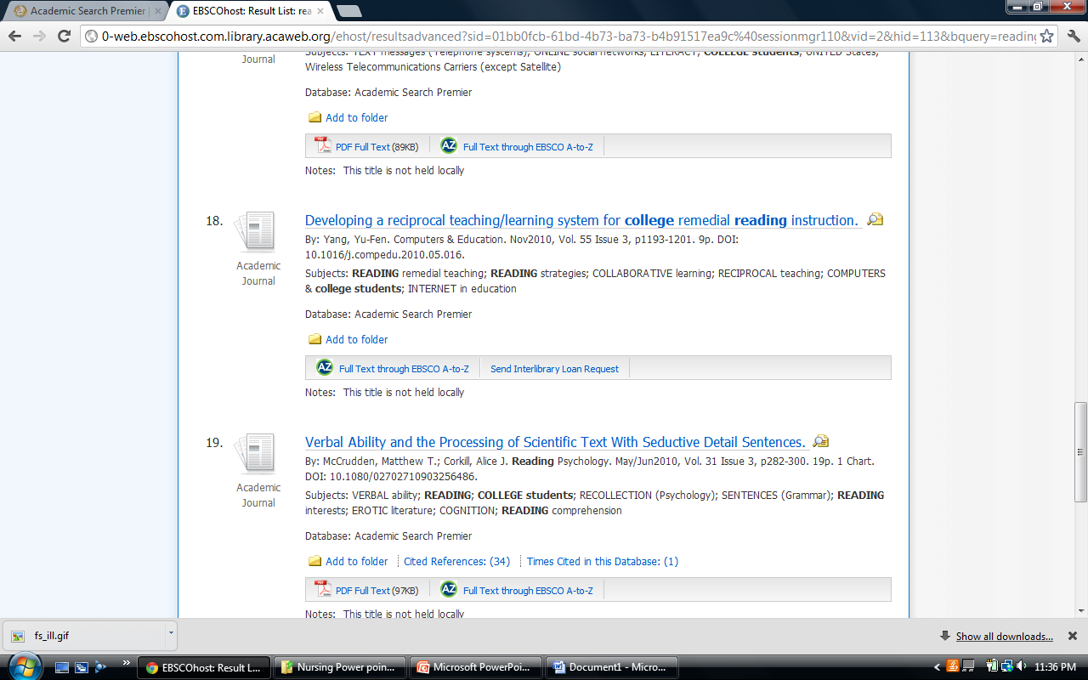
Library Research Tools
Databases
Databases will provide you with electronic journal articles and electronic reference books.
Articles available in full text can be saved or downloaded for student use immediately.
  PDF documents will look exactly like they do if you open up a magazine. This is the best format to use for articles.
  HTML documents will look like a continuous Word document with no page numbers or graphics. If this is the only format available it will be fine but it should not be your first choice if a PDF exists.
Articles that say “Send Interlibrary Loan Request” can be acquired by clicking on the link provided.

Slide 24
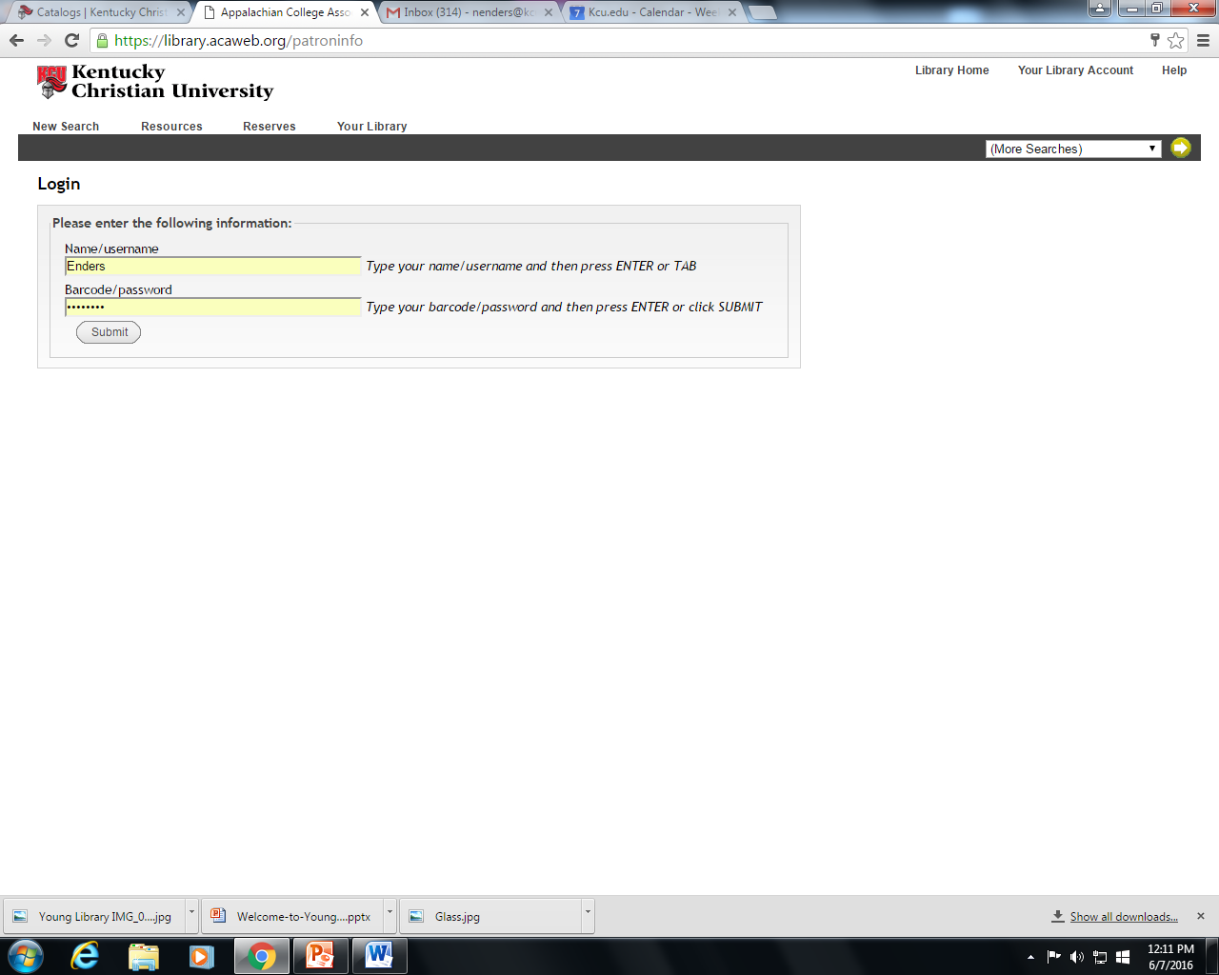
Interlibrary Loan Request
Password Information
Articles and Books that are not available in the library may be acquired for free from other libraries.
Once you have clicked on the ILL request form for an article or book you will need 2 pieces of information – Your Name/Username and
_ Your Barcode / Password
Your Name/ User Name is your last name only with the first letter capitalized.
Example: Name/Username: Enders
Your Barcode/Password is: the letters “kc” followed by the last 6 digits of your ID number.
Example: Barcode/Password: kc123456.

Slide 25
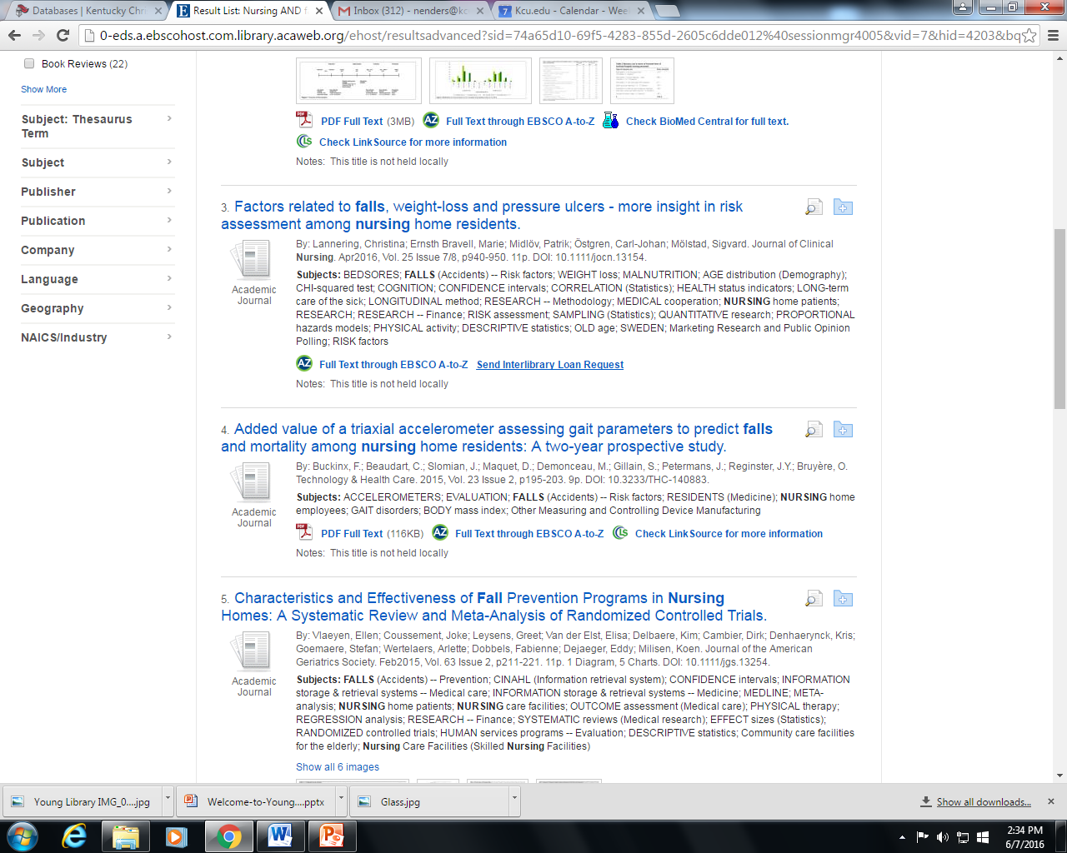
Library Research Tools
Interlibrary Loan
Articles that are not available in full text within the database can be requested through Interlibrary Loan.
For EBSCO databases you will need to click on the “Send Inter Library Loan request” link at the bottom of the article title in the result list.
For other databases you will need to use the form provided in the “resources” area of the Online Catalog. (https://www.kcu.edu/wp-content/uploads/2014/09/Inter-Library-Loan-Forms-and-Information.pdf)
Be sure to fill out all of the requested information. All requests must give us a 10 day window to locate the article or book.

Slide 26

Library Research Tools
Government Websites
Government websites are an important resource for current, statistical information. Do not overlook these sites as resources. Be sure to look at the Government links on the Young Library database page. Data.gov, GovInfo, FCSM – Federal committee on Statistical Methodology and USA.gov are quick ways to locate government websites.
  Government websites can be difficult to navigate. Please contact a librarian if you are not able to locate the information that you are looking for. Remember, we are dealing with these websites regularly. Using us can minimize the time you spend searching and provide you with more time to utilize the information.

Slide 27
Library Research Tools
Helpful Hints for Nursing Research
Narrow your results list on the front page of the advanced search screen. In CINAHL you can set limits such as articles with a nurse as an author.
Be sure to look at the references at the end of any article that contains the exact information you are looking for. The articles may be out of your date range, but you may find additional articles on the topic by the author or other articles on the topic by typing in the article title or author in the database search boxes.
Look at the search terms under the word “Subjects” on your results list. They can help you find terms that you may never have discovered on your own.

Slide 28
Congratulations!
You have reached the end of the Young Library Online Orientation.
I encourage each of you to contact the library if you have any questions or need any help.
Technology changes rapidly. It is our job to keep up with those changes. It is your job to utilize the people and resources available to you.
Take a few minutes to complete the following searches for practice.
Have a wonderful day!

Slide 29
DATABASES – Google Drive Research Folder
Research articles, book pages, bibliographies, rough drafts, etc. can all be saved to a Google folder.
This saves you time and allows you to keep your citations in one place.
To create a folder in Google Drive you will need to begin by signing into your KCU Gmail account.
Follow the process below:

Slide 30

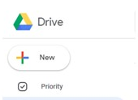
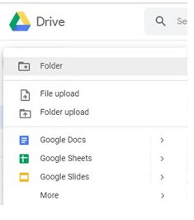
Creating a Research Folder in Google Drive
Click on the ‘waffle’ on the top right of your screen.
Click on the Google Drive symbol in the popup box.
Click on “New” at the top left of the screen.
Click on “Folder”.
Rename your Folder “Research”.

Slide 31
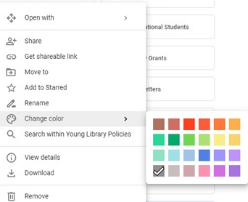
Changing the Color of Your Google Research Folder
Changing the color of your Google Research Folder allows you to identify/ locate the folder more quickly. This will save you time while you are gathering your research.
Hold your cursor over your folder
and right click.
Move your cursor down to “Change Color”.
Click on the color you would like your
folder to be.

Slide 32
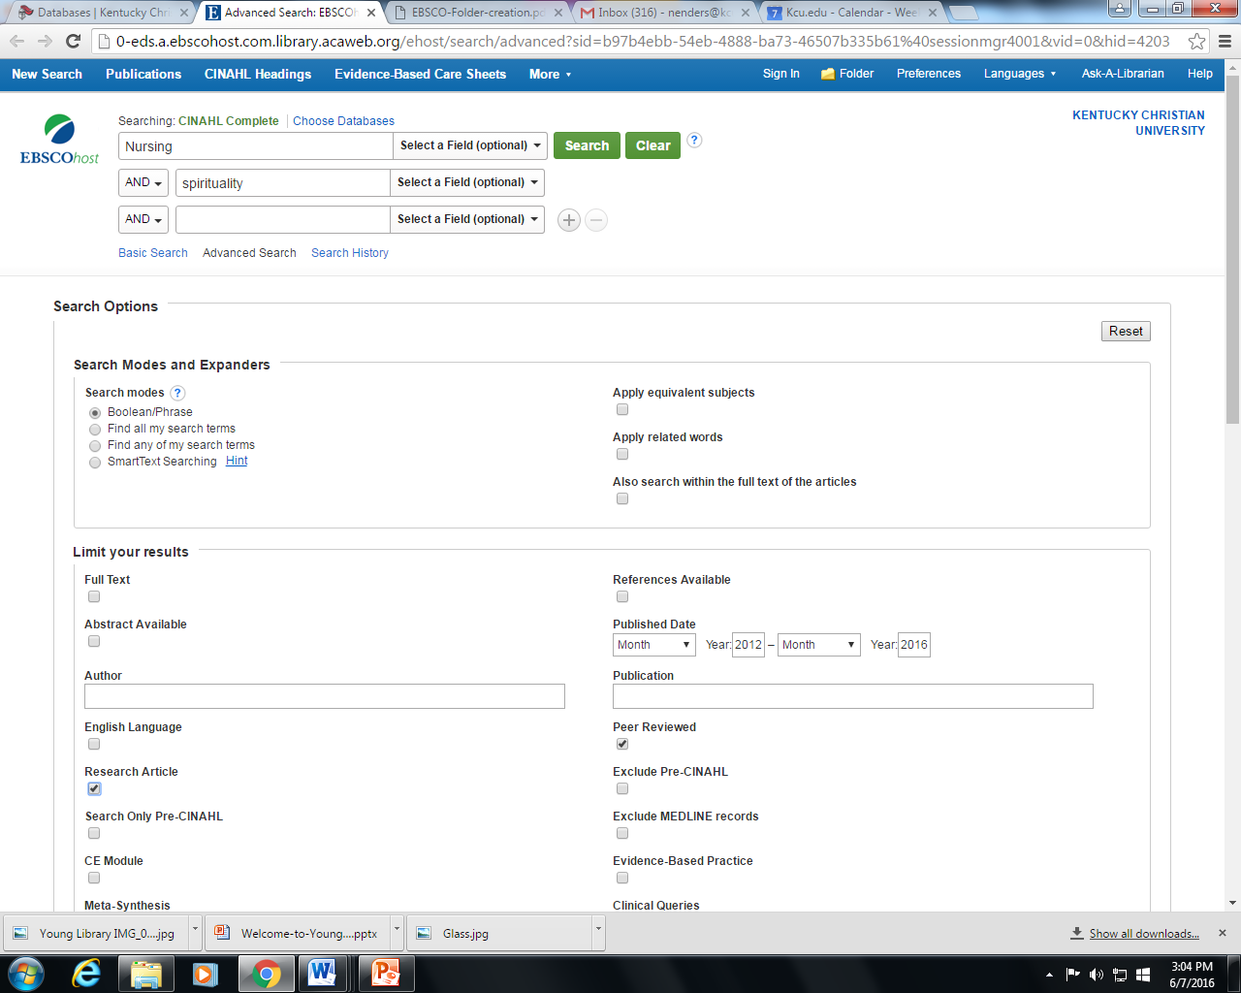
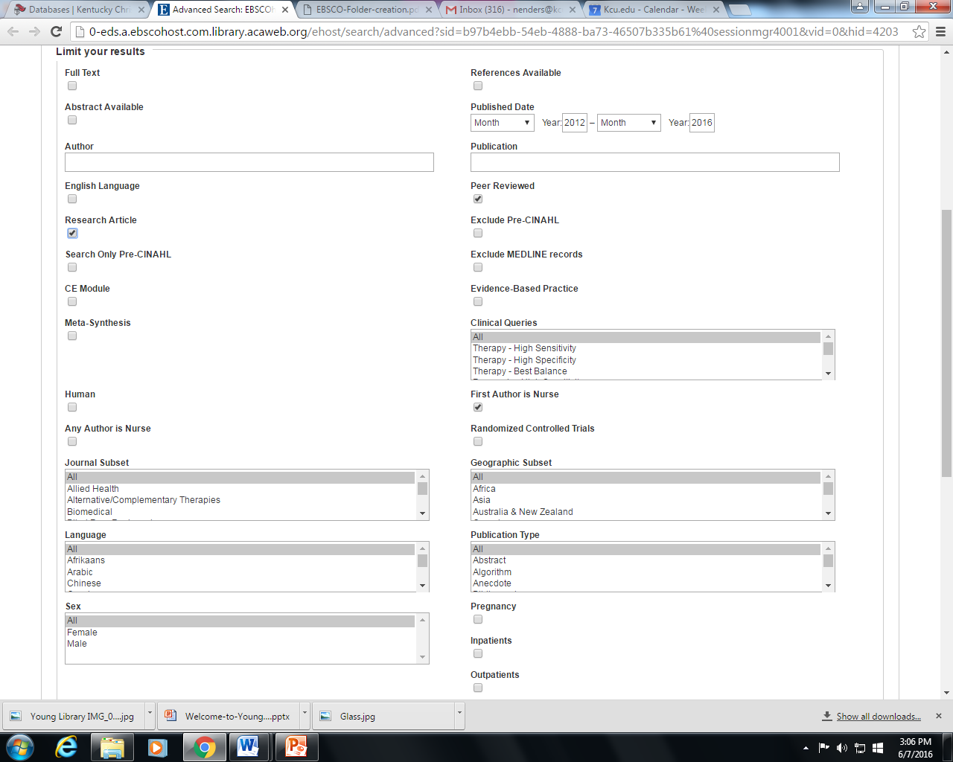
DATABASES – Searching CINAHL
By Subject
Advanced Search Screen
Open the CINAHL Complete Database
In the first box type “nursing”
In the second box type “spirituality”
Scrolling down the Advanced search screen, select the following limits:
  2014 – 2019
  Peer reviewed
  Research article
  First author is a nurse
Be sure you are signed into your Google Gmail/ Drive account.

Slide 33
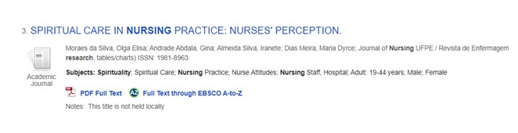
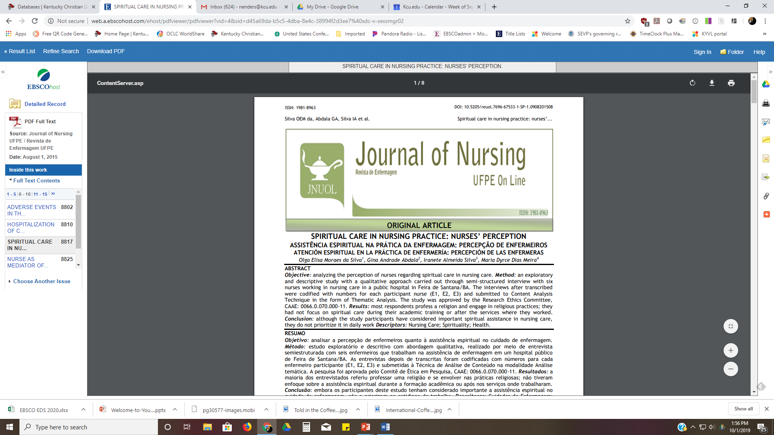
DATABASES – Searching CINAHL
Answer
You should see the following result.
Click on “PDF” at the bottom of the article.
On the tool bar on the right of the article. Click on the Google Drive Symbol.
Open your Google Drive and look for the article under “Recents” then move it into your folder.
Did not work? Contact your librarian.

Slide 34
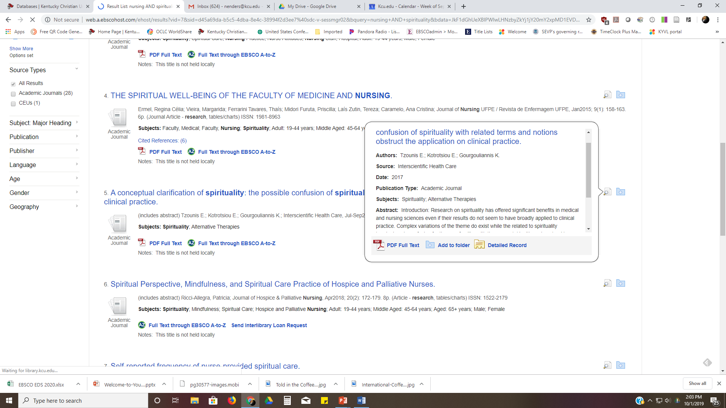
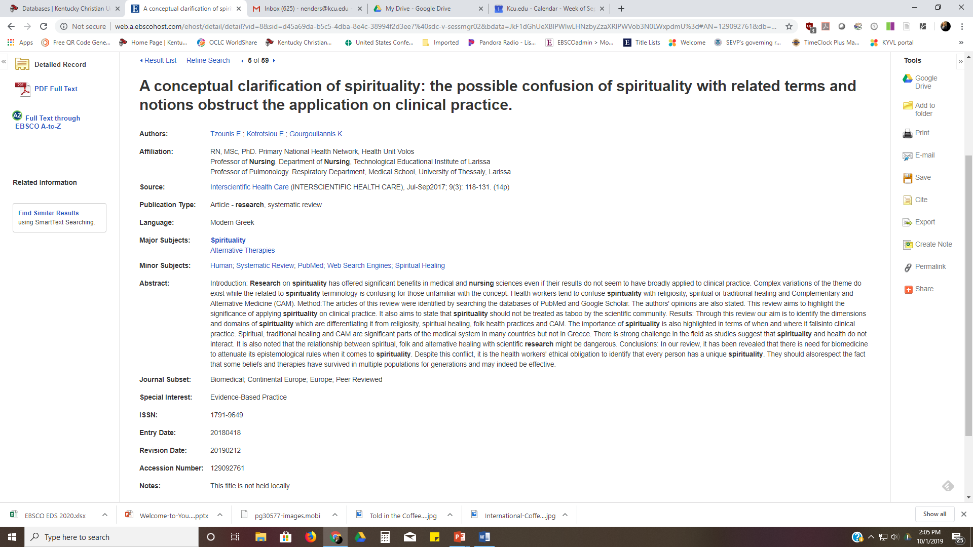
DATABASES – Navigating the result list
Evaluation Tools
Look at the article #5 – “A conceptual clarification of spirituality: the possible confusion of spirituality with related terms and notions obstruct the application on clinical practice.”
Holding your cursor over the magnifying glass at the end of the title shows a summary of the article.
Click on the title. You will see a list of items such as author credentials, journal type and publication type.

Slide 35
DATABASES – Practice Question #1
1. Article #13 – “Nurses' SPIRITUAL CARE PRACTICES: Becoming Less Religious?” says to “Check Young Library holdings”. Click on this link and determine if the issue is available in print at the library.

Slide 36
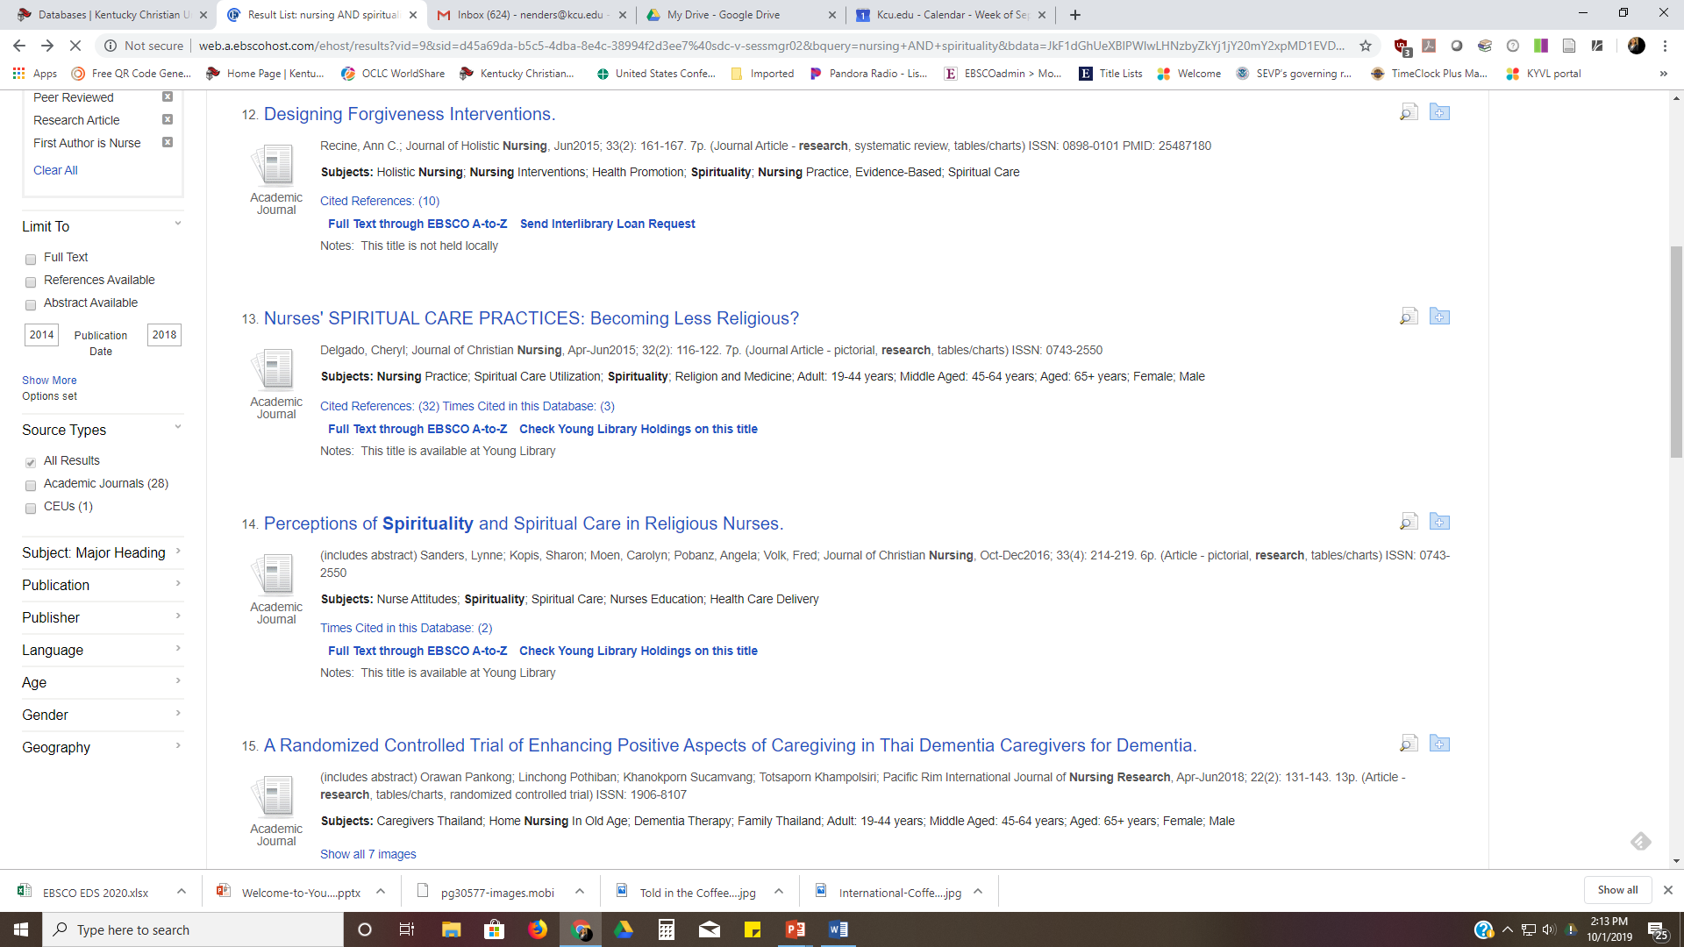
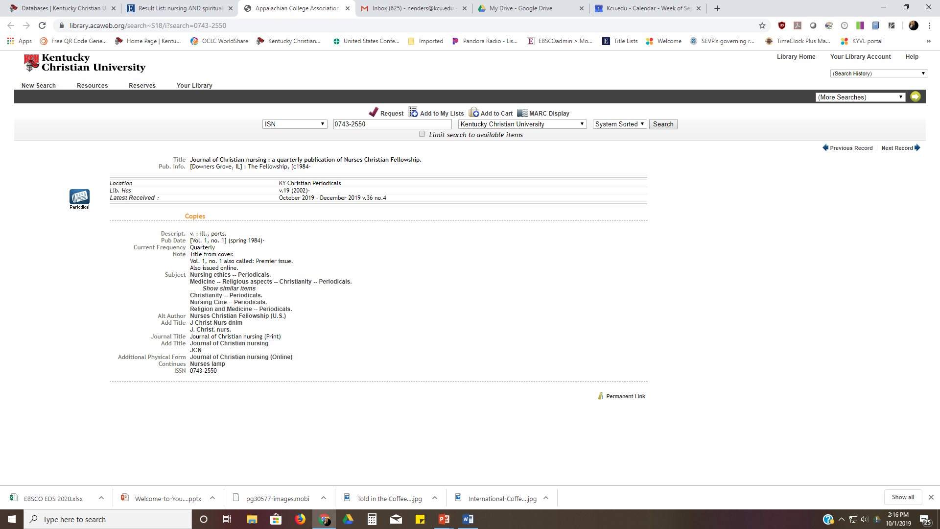
DATABASES – Practice Question #1
Answer
Article #13 – “Nurses' SPIRITUAL CARE PRACTICES: Becoming Less Religious?” is available in Young Library.
  In the citation this article is in the journal Journal of Christian Nursing and is in the Apr/June 2015 issue. This is Volume 32 Issue 42
  Clicking on the link opens the library catalog. The library holdings begin with Volume 19, therefore this article is in the library.

Slide 37
DATABASES – Practice Question #2
2. Type in the title “The experience of nursing students facing death and dying” in the search box at the top of the screen. This is a full text article. Click on the title and read the abstract. Is this a qualitative or quantitative study?

Slide 38
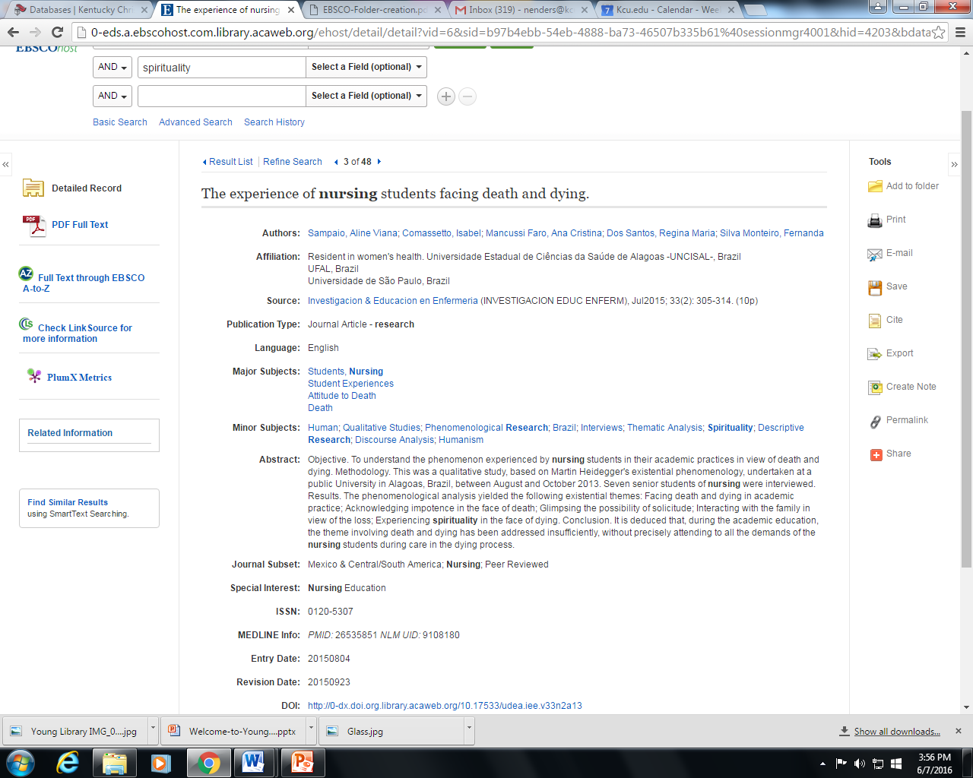
DATABASES – Practice Question #2
Answer
2. Article #3 – “The experience of nursing students facing death and dying” is a full text qualitative article. The methodology clearly states that it is a qualitative study. This does not happen in every Abstract but looking in the methodology of the articles will help you make that determination.

Slide 39
DATABASES – Practice Question #3
3. Type in the title “Nursing Student Perceptions of Spirituality and Spiritual Care” says to “Send Interlibrary Loan Request”. Click on this. Your filled in request form should appear. What are the pieces of information that you need to complete the form?

Slide 40
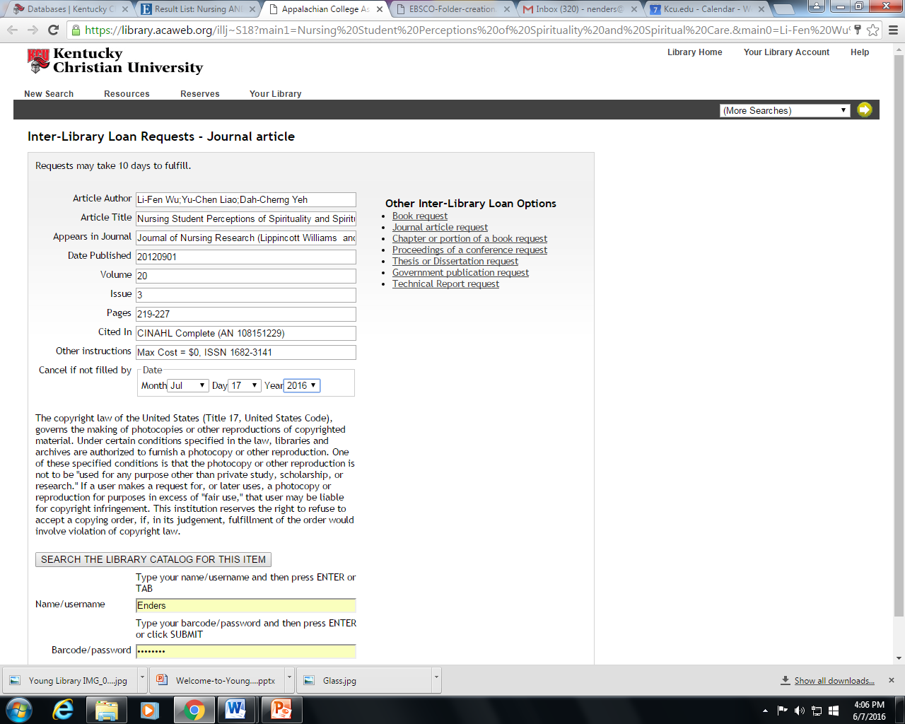
DATABASES – Practice Question #3
Answer
3. Article – “Nursing Student Perceptions of Spirituality and Spiritual Care” needs three pieces of information:
  Your Name/Username – Last name only first letter capitalized
  Your Barcode/Password – “kc” plus the six digits of your ID number
  The Date that you need the article by

